Slide 1

PENGOLAHAN SAMPAH ORGANIK MENJADI PUPUK ORGANIK ECOBOOST LIQUID SEBAGAI UPAYA MENANGANI MASALAH SAMPAH DI DAERAH PASAR KAMPUNG LALANG
ECOBOOST LIQUID
GAGASAN KREATIF
BY
YENNI THERESIA ZALUKHU

Slide 2


Agenda Page
01
03
ISSUE
02
GOALS
NEGATIVE IMPACT

Slide 3
Agenda Page
04
06
BENEFITS
05
PROCESS OF MAKING ECOBOOST LIQUID
CREATIVE PRODUCT (PREPARATION STAGE)

Slide 4
Agenda Page
07
09
ECOBOOST LIQUID APPLICATION
ON THE PLANTS
08
Q&A SESSION AND CLOSING
MULTIDISCIPLINARY APPLICATION TABLE

Slide 5
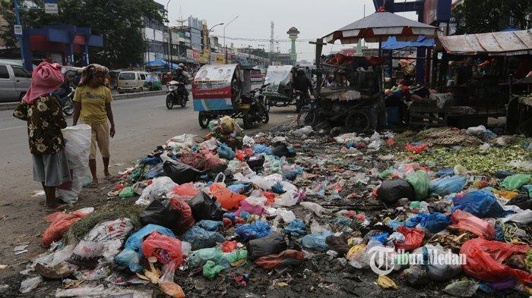
What’s The Matter?
Image source: Tribun-Medan.com
The amount of garbage scattered in the kampung lalang market causes the environment to become dirty and polluted.

Slide 6
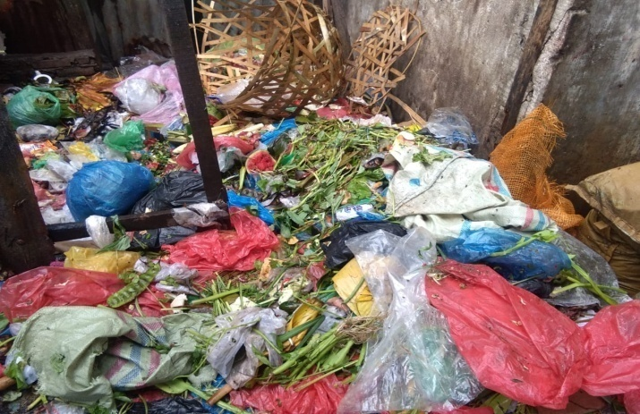
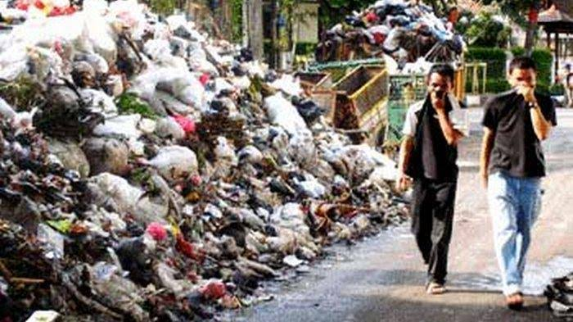
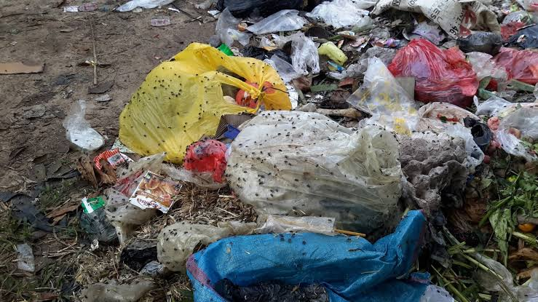
Negative Impact
Pile of garbage
Unpleasant Odor
Flies carry disease

Slide 7
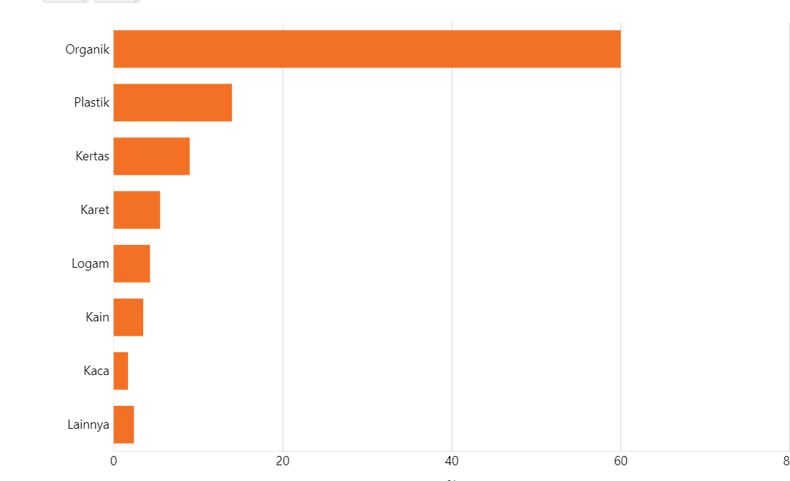
The Composition of Waste in Indonesia by Type
Based on data from the Ministry of Environment and Forestry (KLHK)

Slide 8
So, what's the goal?
GOAL
TURN WASTE INTO ORGANIC FERTILIZER CALLED ECOBOOST LIQUID
UTILIZING ECOBOOST LIQUID ORGANIC FERTILIZER ON PLANTS
REDUCING THE PILE OF GARBAGE

Slide 9
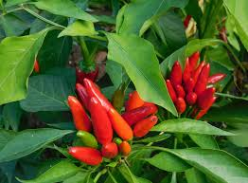
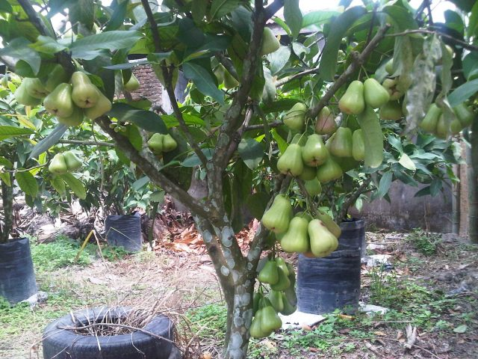
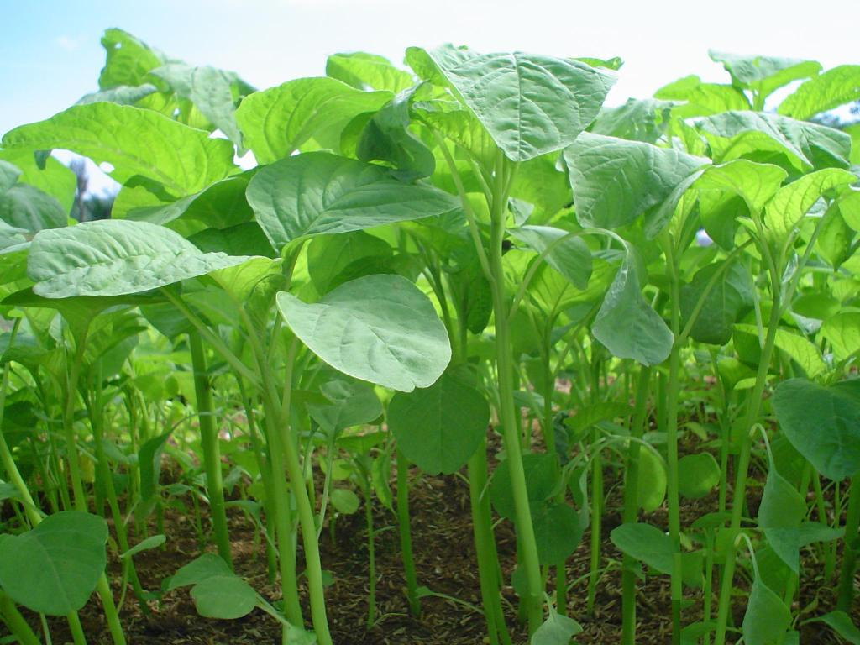
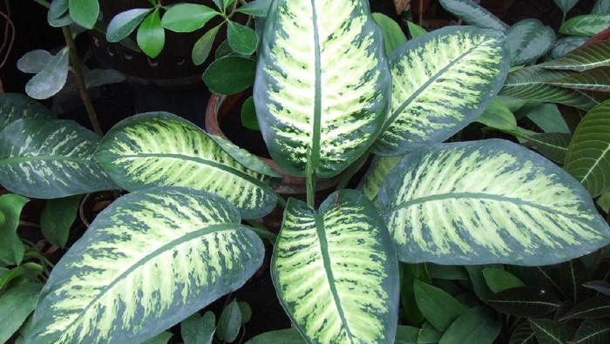
BENEFITS

Slide 10
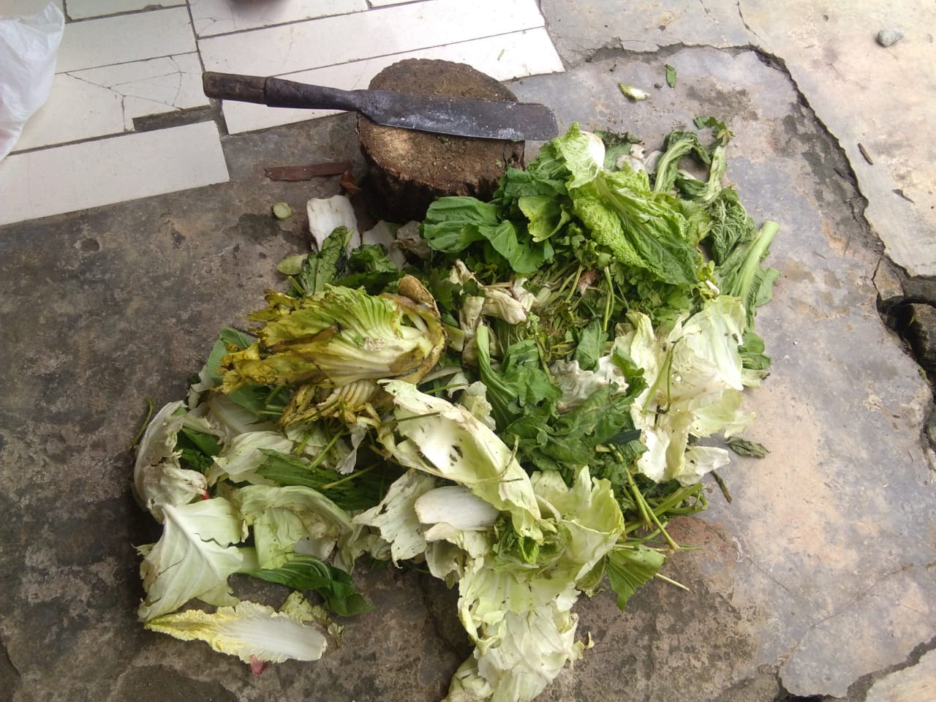
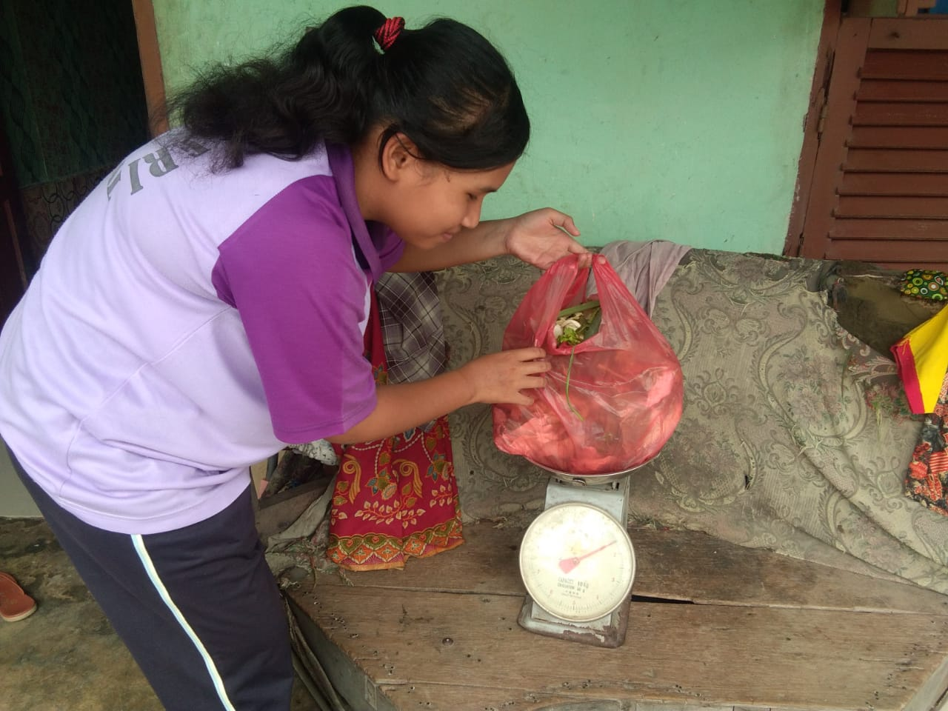
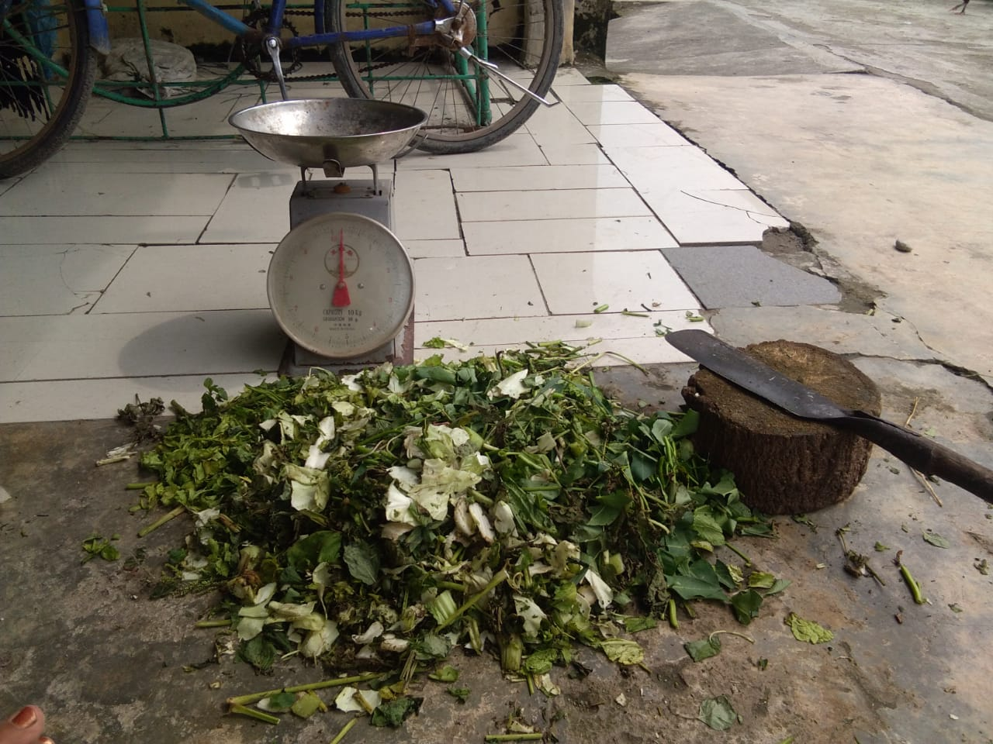
CREATIVE PRODUCT (PREPARATION STAGE)
Sorting out organic waste
Weighing the sorted waste
Cutting the sorted waste into ± 2 cm pieces

Slide 11
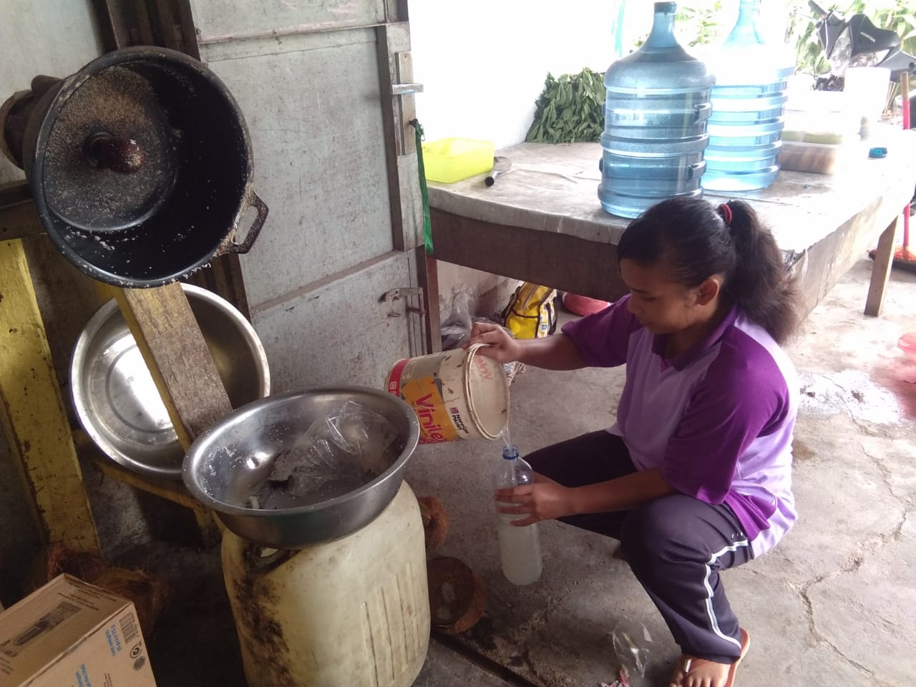
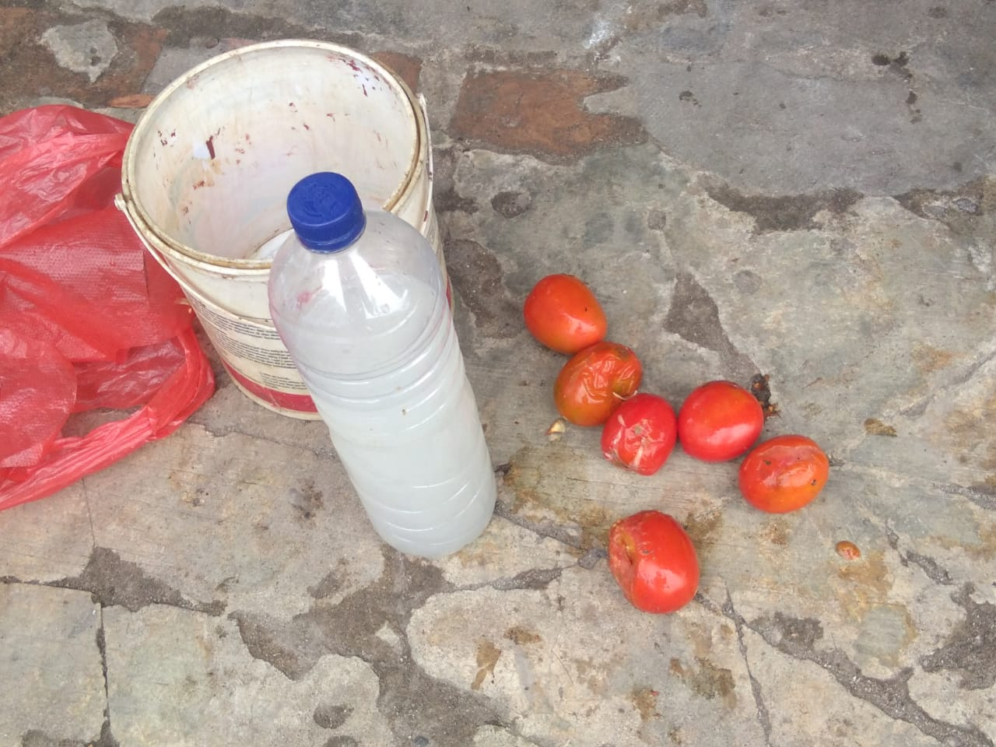
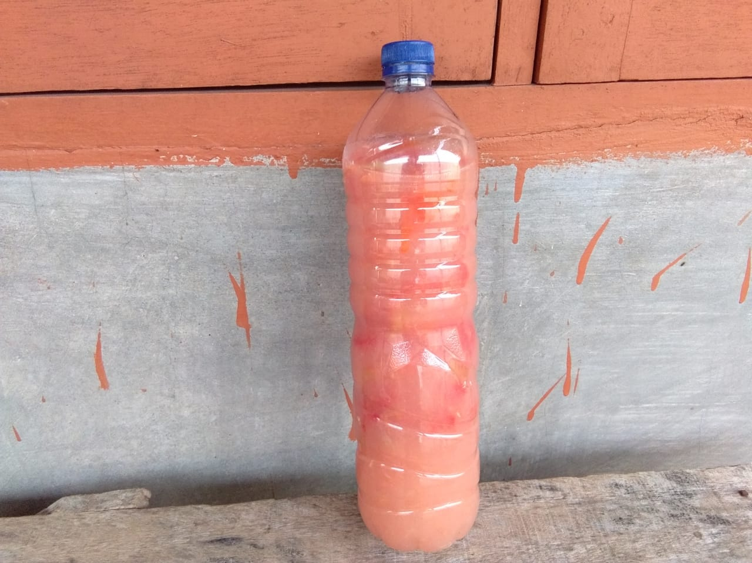
CREATIVE PRODUCT (PREPARATION STAGE)
Retrieving coconut water waste
Mixing coconut water waste with rotten tomatoes
Both ingredients are fermented for 1 week

Slide 12
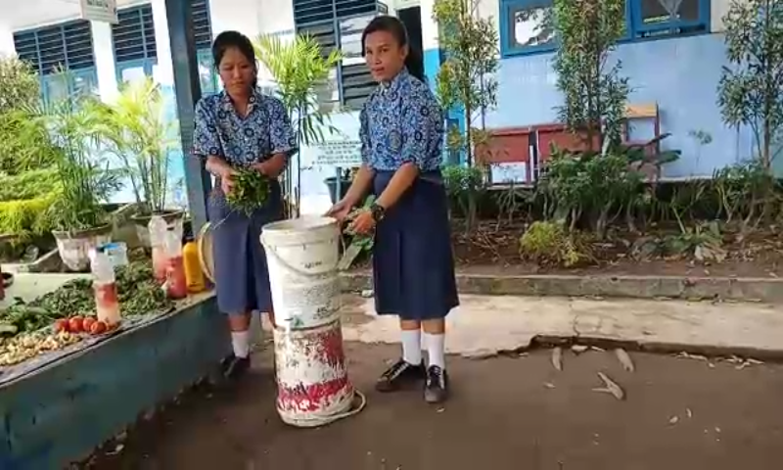
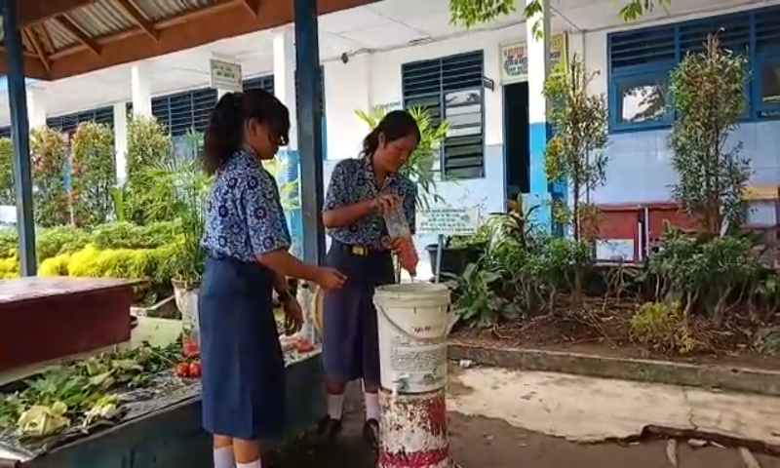
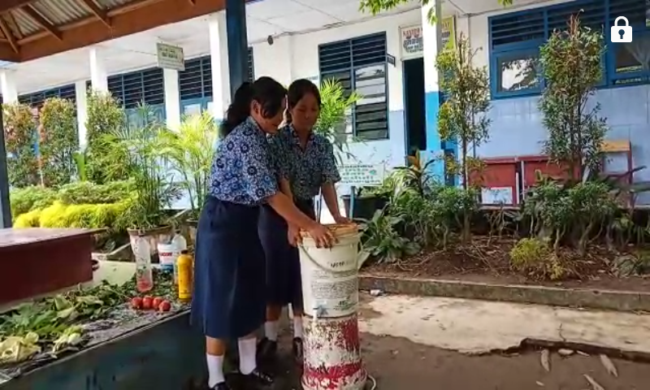
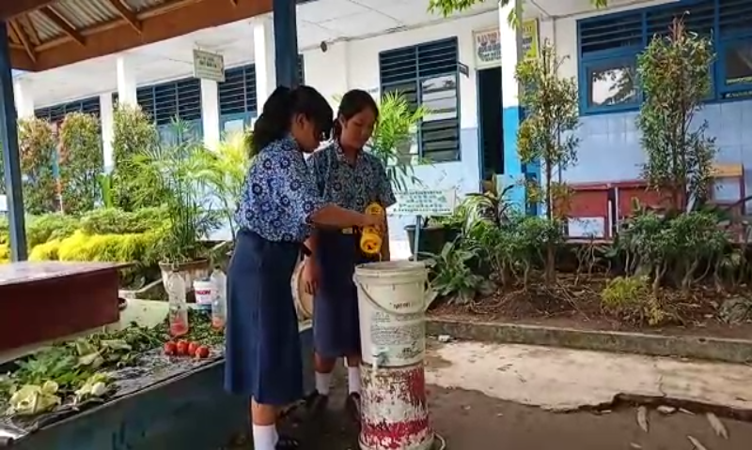
PROCESS OF MAKING ECOBOOST LIQUID (How To Make)
Putting organic waste into used paint barrels
Watering organic waste with fermented coconut water waste with rotten tomatoes
Capping the used paint barrel and letting it sit for 1 week
Flushing organic waste with EM 4 microorganisms

Slide 13
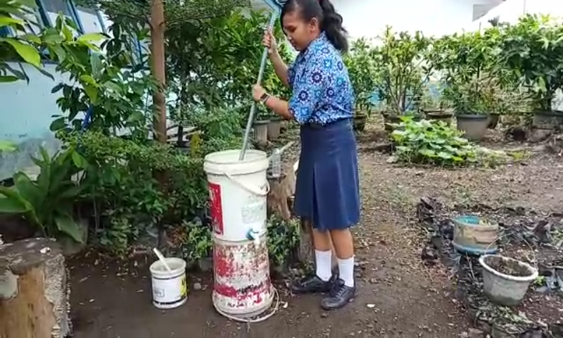
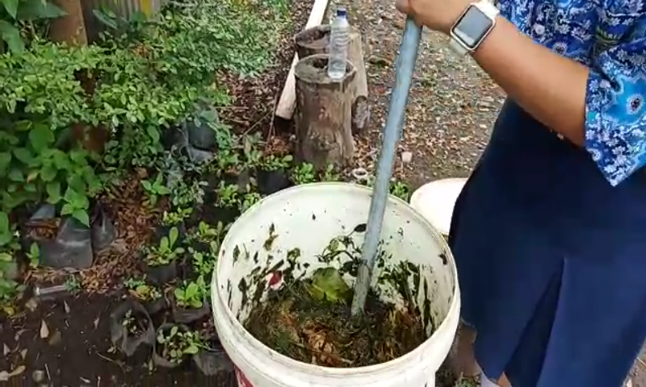
PROCESS OF MAKING ECOBOOST LIQUID (How To Make)
Fermented organic waste must be stirred after 1 week.

Slide 14
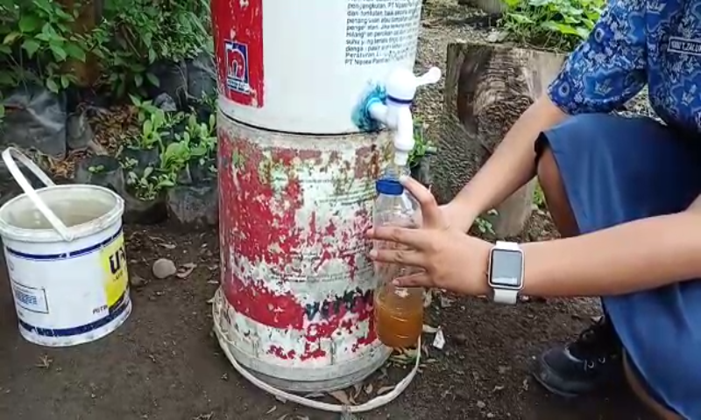
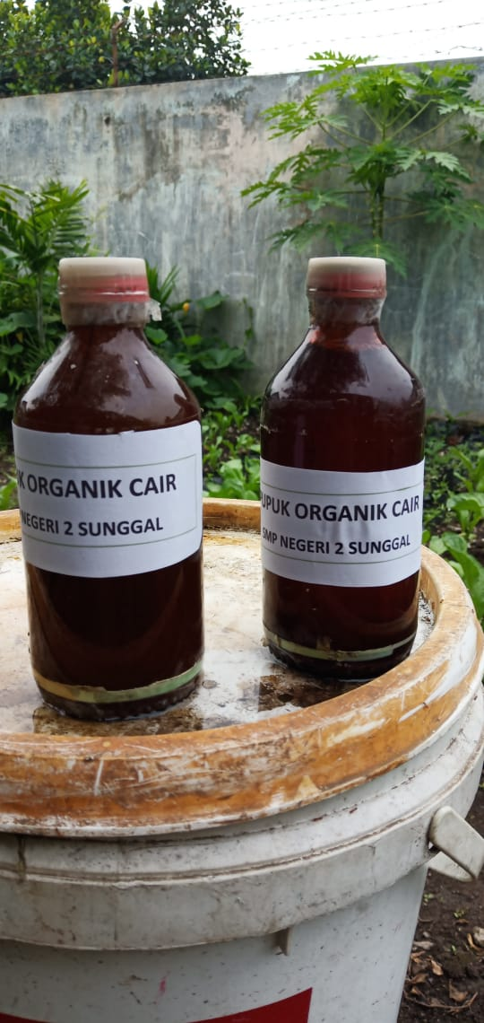
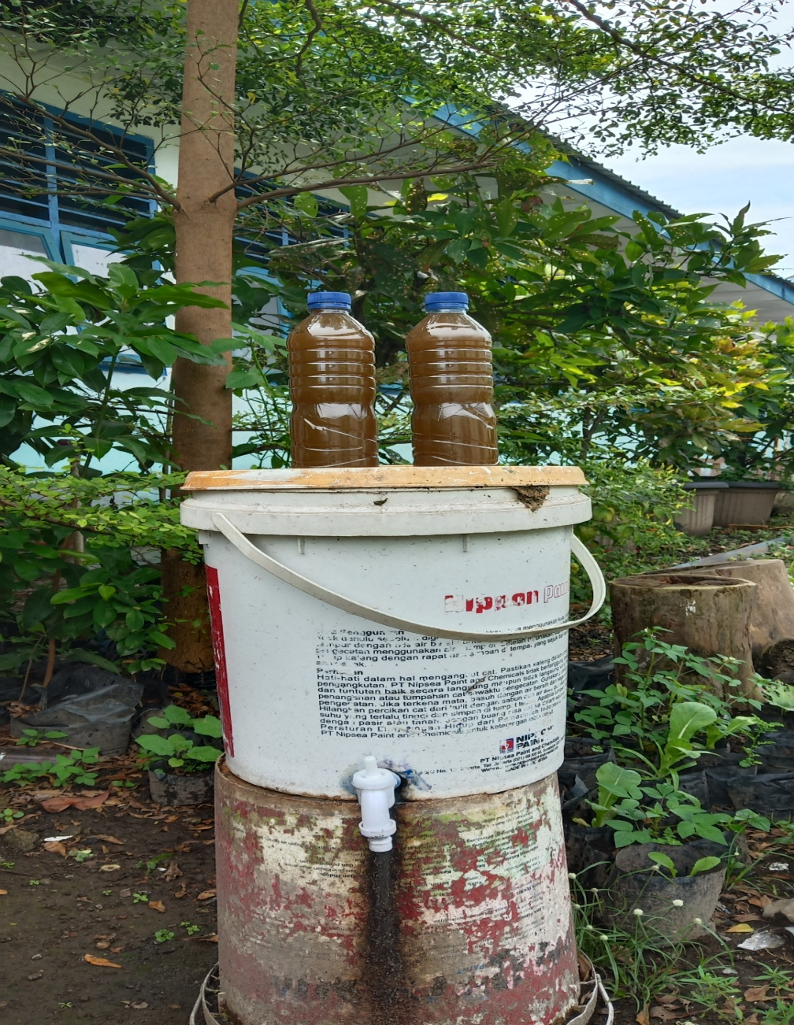
ECOBOOST LIQUID FERTILIZER PRODUCTS
THE OUTPUT PRODUCT IS A LIQUID ORGANIC FERTILIZER NAMED ECOBOOST LIQUID.

Slide 15
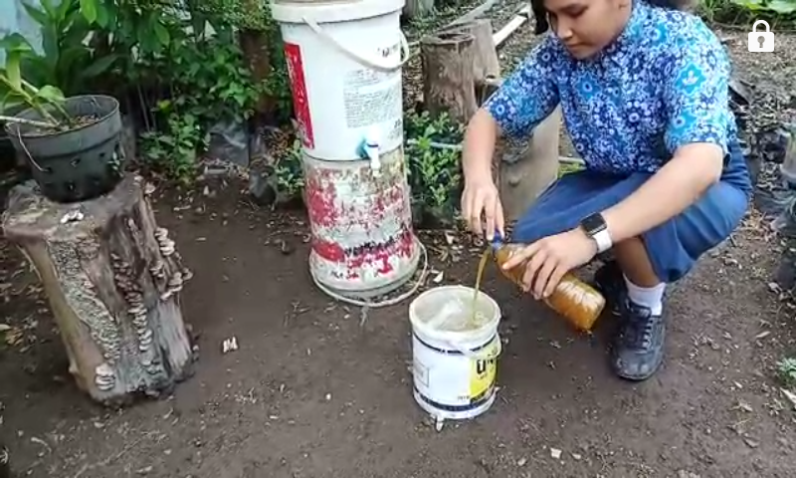
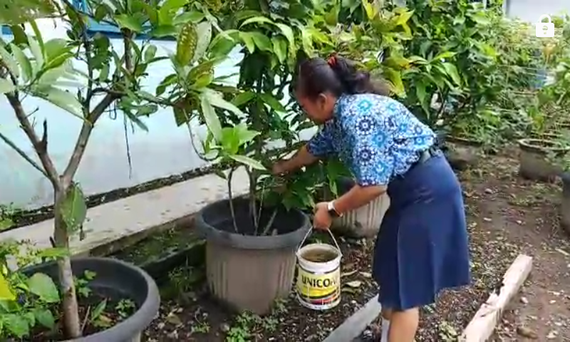
Mix 500 ml of leachate water into 5 liters of water, then stir evenly. after that the mixture can be poured into the plant.
ECOBOOST LIQUID APPLICATION
ON THE PLANTS

Slide 16
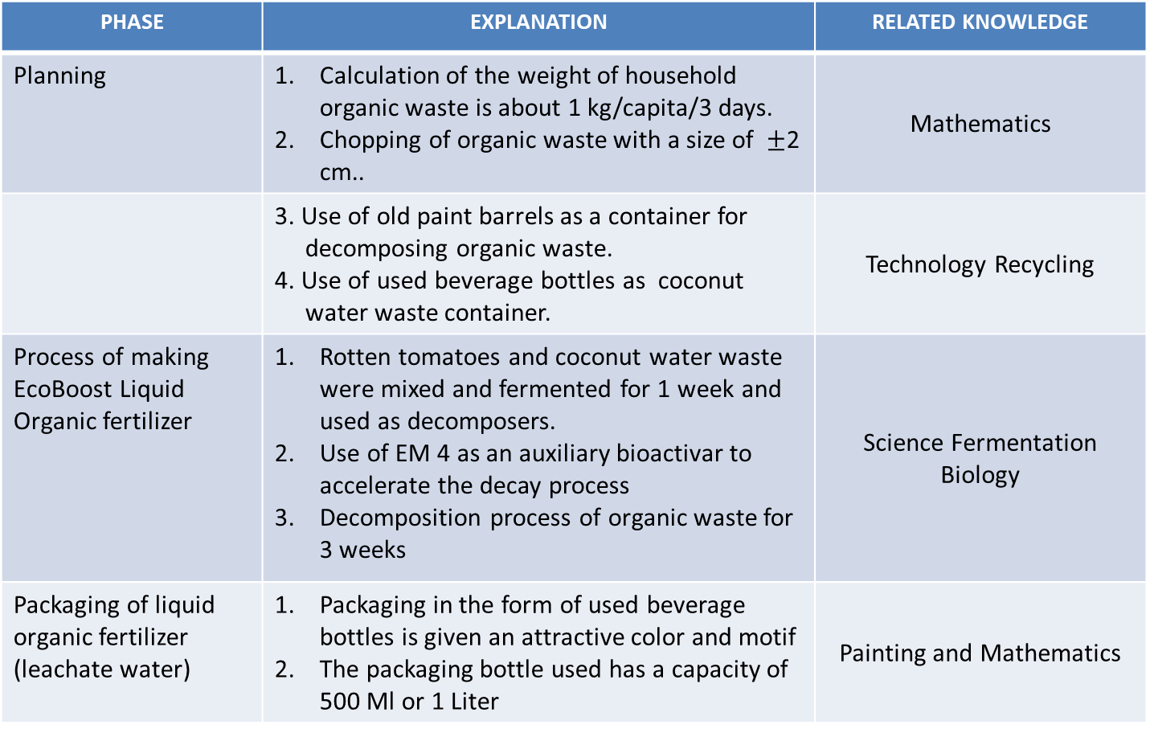
MULTIDISCIPLINARY APPLICATION TABLE
PHASE | EXPLANATION | RELATED KNOWLEDGE
Planning | Calculation of the weight of household organic waste is about 1 kg/capita/3 days. Chopping of organic waste with a size of $±$2 cm.. | Mathematics
 | 3. Use of old paint barrels as a container for decomposing organic waste. 4. Use of used beverage bottles as coconut water waste container. | Technology Recycling
Process of making EcoBoost Liquid Organic fertilizer | Rotten tomatoes and coconut water waste were mixed and fermented for 1 week and used as decomposers. Use of EM 4 as an auxiliary bioactivar to accelerate the decay process Decomposition process of organic waste for 3 weeks | Science Fermentation Biology
Packaging of liquid organic fertilizer (leachate water) | Packaging in the form of used beverage bottles is given an attractive color and motif The packaging bottle used has a capacity of 500 Ml or 1 Liter | Painting and Mathematics

Slide 17
REFERENCES
Buku Laporan Adiwiyata SMP Negeri 2 Sunggal tahun 2014
https://www.kompasiana.com/amp/lhapiye/air-sampah-jadi-pupuk-tanaman-bisa-kok_589e5d2b937e611a0eebc846
https://core.ac.uk/download/pdf/19892260.pdf
https://id.m.wikipedia.org/wiki/Air_lindi
https://media.neliti.com/media/publications/190743-ID-pemanfaatan-limbah-tomat-sebagai-agen-de.pdf

Slide 18
Thank You
Struggle that I do today is the single way to build a better future.
If I cannot do great things, I can do small things in a great way.
~ Martin Luther King, Jr. ~

